Slide 1
Global oriens Nepal pvt. Ltd Balaju-16, Kathmandu
WE ASSURE YOU COMPLETE WELLNESS- FINANCIAL AS WELL AS SOCIAL

Slide 2
About us:
Licensed Company under Nepal Direct Selling Act
Member of Nepal Direct Selling Association (NDSA)
Head Office located at Capital City ( Balaju, Kathamandu)
We are always ready to welcome you at our branches located at various parts of Nepal. We are on the verse of expanding our Sales Counter on different prime location of Nepal. Please feel free to be updated through our website https://globaloriensnepal.com/
Alliance with International Exporter Company Vijayani Nutraceutical (Based on Chennai) for nutraceuticals products and local renowned herbal companies for cosmetic products.
Self manufacturing unit equipped with modern scientific R&D team.

Slide 3
We offer:
Ayurveda + Siddha + Unani formulated Nutraceutical (double extracted) Food supplements certified with USFDA, CFTRI, ISO, HALAL, FSSAI and others.
Locally manufactured Cosmetic Products with GMP Standard suitable for Nepalese costumers
Facile on acquiring distributorship
Potentialities:- More Sales---Multi Benefits
Yearly Celebration with Media Exposure.

Slide 4
Our products:
Cosmetics
Nutraceuticals
Regular
Total Antioxidant 2. Naturovita
3. Diacare 4. Arthobest
5. De-Lipo 6. Asparose
7. Oriens Strong Liv 8. Nephrofit
9. Detoxy One 10. Fruit Fiber
11. Wheatgrass 12. Panax Ginseng
1. Ori-Hygiea Soap
2. Bio-Glow Face Wash
3. Bio-White Face Scrub
4. Ori- Antifrizz 2 Step Shampoo
5. Ori-Dent Toothpaste
6. Ori- Smile Toothpaste
Ultracare Sunshield
Skin Vita Body Lotion
Glowfest Day Cream
Glowfest Night Cream
Ori-Joints Care
Ultracare Whitening Kit 6 Steps

Slide 5
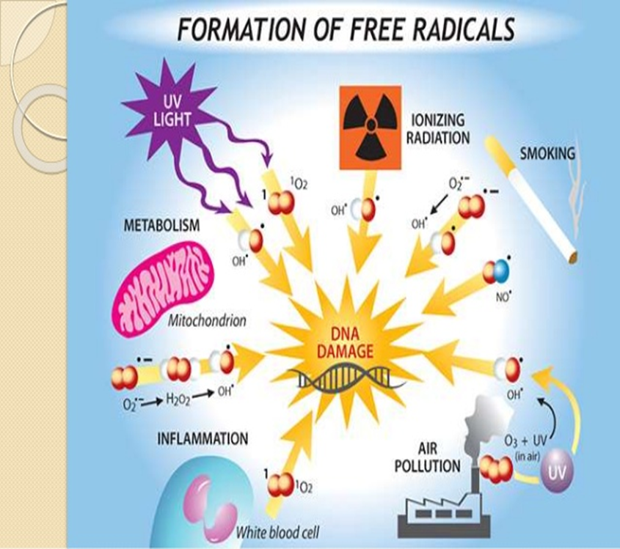
Nutraceuticals Total antioxidant
Ingredients:
Lutein, Lycopene, Proanthocyanin, Phytosterol, Curcumin, Piperine
Benefits:
Scavenges the Free Radicals
❖ Relives Inflammation
❖ Helps Reduce Risk of Cancer
Cell rejuvenator
❖ Strengthens Vision, Memory, Heart

Slide 6
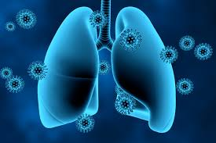
Naturovita
Ingredients:
Boswellia serrata, Spirullina
Benefits:
Improves blood circulation
❖ Enhances lung function
❖ Osteoarthritis
❖ Anti inflammatory
❖ Supports the liver

Slide 7
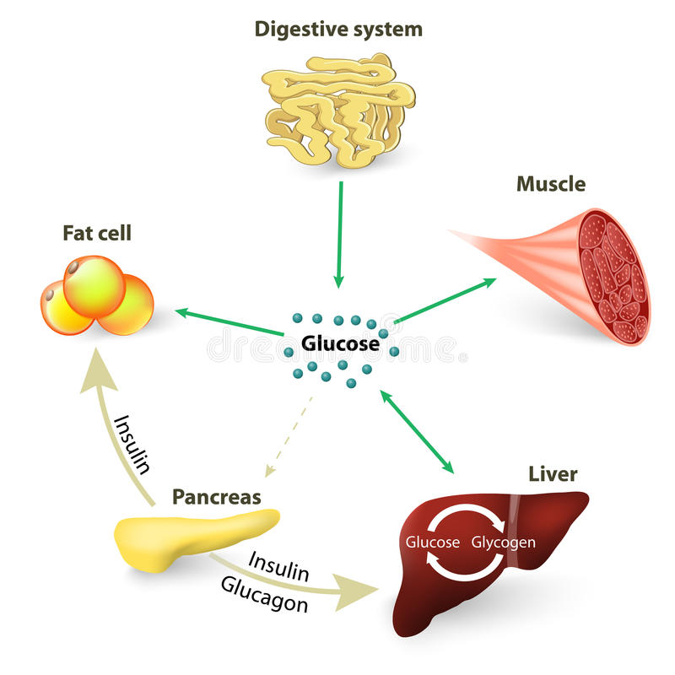
Diacare
Ingredients:
Lagerstroemia flos, Tinospora cordifolia, Gymnema sylvestre, Cinnamomum zeylanicum
Benefits:
Helps to maintain & balance
blood sugar
❖ Enhance the secretion of
Insulin
❖ Helps in Digestive process
❖ Reduce cholesterol level
❖ Controls and regulate weight

Slide 8
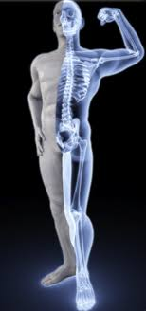
Arthobest
Ingredients:
Glucosamine sulphate, Chondroitin Sulphate, Methyl Sulfonyl Methane
Benefits:
Natural supplement
❖ Helps build proteins that repair body tissues
❖ Helps prevention of osteoarthritis
❖ Inflammatory bowel disease
❖ Chronic venous insufficiency

Slide 9
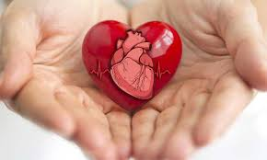
De- lipo
Ingredients:
Mangosteen extract, Grape seed extract, Polycosanal, Xanthos
Benefits:
Anti-Biotic (Modulates Bacterial Infections)
❖ Anti- Lipidemic (Blood Fat Lowering, LDL)
❖ Anti-Fungal (Prevents Fungal Infections)
❖ Anti-Aging, Anti-Oxidant, Anti-viral
❖ Prevents Hardening of Arteries
❖ Prevents Skin Disorders
❖ Protects the Heart

Slide 10
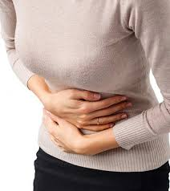
Asparose
Ingredients:
Asparagus racemos, beta-carotene, Thiopolyphenol, Biopeperine
Benefits:
Strengthens the uterus
❖ Relieves Menstrual Problems
❖ Improves Blood Circulation
❖ Best source of Antioxidants
❖ Reduce Bad Cholesterol

Slide 11
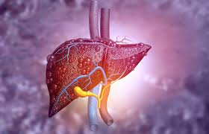
O’ strong liv
Ingredients:
Silybum marianum extract, Picrorhiza kurroa extract, Phyllanthus amarus extract, Tinospora cordifolia extract, Terminalia arjuna extract
Benefits:
Helps to strengthen the liver and lungs
❖ Detoxify the liver
❖ Hepatic- protect ant
❖ Anti – Asthmatic
❖ Anti – Allergic
❖ Anti - Inflammatory agent
❖ Immune modulator

Slide 12
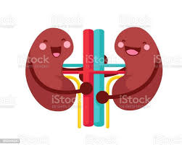
Nephrofit
Ingredients:
Crataeva nurvala extract, Piper nigram extract
Benefits:
Strengthen the urinary tract
❖ Helps to maintain urea and creatinine level
❖ Helps to reduce kidney stones
❖ Anti-arthritic
❖ Anti-inflammatory

Slide 13
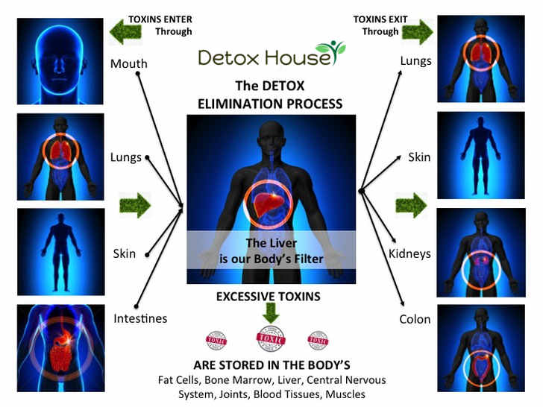
Detoxy one
Ingredients:
Picrorhiza kurroa extract, Inula racemosa extract, Lactobacillus, Zingiber officinale extract, Silybium marianum extract
Benefits:
To remove toxins from the body
❖ To help in the free radical scavenging
❖ To help in the digestive process
❖ To help in liver support
❖ To help in strengthen the organs
❖ Works to Boost Metabolism
❖ Optimizes Nutrient Utilization

Slide 14
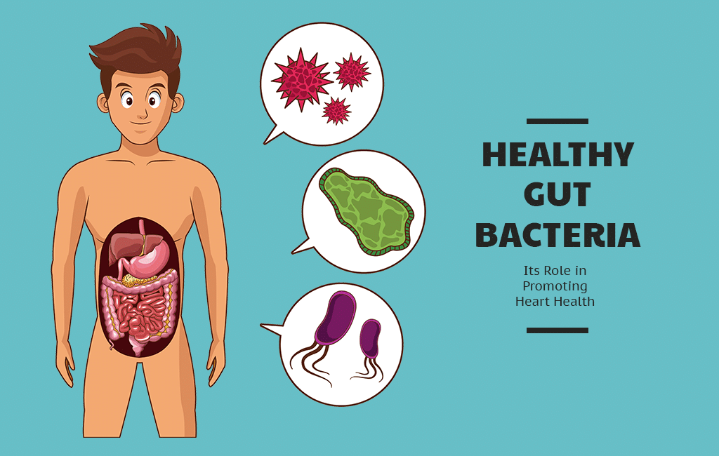
Fruit fiber
Ingredients:
Aegle marmelos extract, Bacillus coagulans
Benefits:
❖Helps to relieve from constipation
❖Supports heart and lungs
❖Enhances food absorption
❖Powerful skin and hair rejuvenator
❖Reduces body heat and/or weight naturally
❖Restores stomach and digestive enzymes

Slide 15
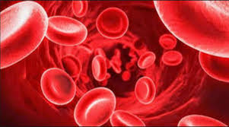
Wheatgrass
Ingredients:
Wheatgrass powder
Benefits:
Purifies the blood in the entire body.
❖ It increases the red blood count.
❖ It is an excellent skin cleanser.
❖ It boosts the immune system.
It enhances the capillaries and reduces
❖ It boosts the hemoglobin production.

Slide 16
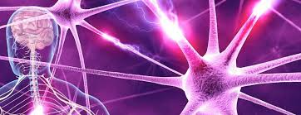
Panax ginseng
Ingredients:
Panax ginseng extract
Benefits:
Lowers Bad Cholesterol
❖ Lowers high blood pressure
❖ Increases good cholesterol
❖ Prevents cellular damage from oxidation
❖ Stimulates intestinal digestion
❖ Improves nerve transmission
❖ Increases physical stamina
❖ Strengthens the immune system

Slide 17
Regular items Ori- hygiea soap
Ingredients:
Honey, Hygiea, Olive Oil, Neem Oil, Aloevera Gel, Chiuree Gheu, Natural, Glycerine, Ganoderma (Rato Chyau)
PROPERTIES:
Useful in wound healing, sunburned skin, allergies and hyper pigmentation.
It helps to remove acne scars and makes the skin radiant, smooth, supple and fair.
It is anti- inflammatory, and is extremely beneficial on minimizing wrinkles and on removing skin-based harmful microbes.

Slide 18
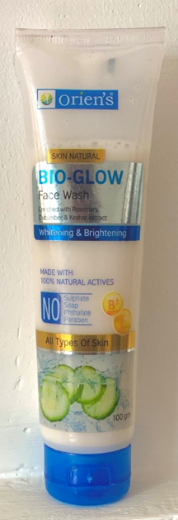
Bio- glow face wash
Ingredients:
Aqua, Decyl, Vitamin E, Vitamin B5, Almond Oil, Keshar Extract, Cucumber Extract, Rose marry Extract, etc.
PROPERTIES:
Orien’s Bio glow face wash is enriched with Rose marry, Cucumber, Almond oil, Sandalwood extract, Keshar extract and is 100 % soap free, sulphate free, phthalates free and paraben free that gently cleanses your face and removes oil.
Unlike soap your face will not feel dry and stretched.
Rosemary increases skin elasticity therefore promotes a healthy moisturized scalp.
Cucumber is valuable source of a variety of nutrients and has cooling effect on skin.
Keshar have skin lightening and brightening properties.
Almond oil improves skin tone and complexation.
PRECAUTIONS:
Store in cool and dry place.
Keep out of reach of children.
Avoid contact with eyes, In case of contact rinse immediately with water.

Slide 19
BIO- WHITE FACE SCRUB
Ingredients:
Aqua, Perfume, Glycerin, Vitamin E, Vitamin B5, Kesar Extract, Cetyl alcohol, Wheat germ oil, Polysorbate 20, Carrot seed oil, etc.
PROPERTIES:
High quality range.
Ideal for all skin types.
Orien’s Bio-White Face Scrub which is enriched with Wheat germ oil, Carrot seed oil, Kesar extract, Vitamin E and B5 and is 100 % soap free, sulphate free, phthalates free and paraben free which reduces skin imperfections by exfoliating and refining skin to allow for a more youthful glow.
Carrot seed oil and Wheat germ oil removes dead skin cells and black heads smoothly to reveal softer skin and also acts as anti ageing.
Kesar Extract gives glow with lightening and brightening properties.
PRECAUTIONS:
Store in cool and dry place.
Keep out of reach of children.
Avoid contact with eyes, In case of contact rinse immediately with water.

Slide 20
Ori- Antifrizz 2 step shampoo
Ingredients:
Amala, Perfume, Sikakai, Glycerin, Olive oil, Argan oil, Citric acid, Sarcosinate, Proteol APL, D-Panthenol, Niacinamide, Thuja Extract, Provitamin B5
PROPERTIES:
High quality range.
Ideal for all skin types.
Ori- ANTIFRIZZ two-step shampoo is non-drying, soothing, conditioning and instant anti-frizz therapy free from SLS, SLES, Phthalates and paraben.
Thuja Extract which is ideal moiety address hair loss and promotes the hair growth. Organic Shea Butter and Pro vitamin B5 moisturizes and Nourishes hair which ensures suppleness, flexibility and strength.
Amala Build collagen to strength the hair.
PRECAUTIONS:
Store in cool and dry place.
Keep out of reach of children.
Avoid contact with eyes, In case of contact rinse immediately with water.

Slide 21
Ori- dent toothpaste
Ingredients:
Basil, Neem, Fennel, Clove oil, Gel Base, Cinnamon, Camphor oil, Babool extract, Peppermint oil, Bajradanti extract
PROPERTIES:
High quality range.
ORI-DENT Toothpaste is 100 % Vegetarian Calcium free.
Triclosan free toothpaste which is formulated with the blend of several herbal actives that makes teeth stronger, shiner and healthier gums.
ORI-DENT Toothpaste fights germs in the mouth itself and stop germs from entering the body.
Unique formula created with numerous Ayurveda ingredients have gum care, freshness, gum massage, strengthening and anti-germ properties.
PRECAUTIONS:
Store in cool and dry place.
Keep out of reach of children.
Avoid contact with eyes, In case of contact rinse immediately with water.

Slide 22
Ori- smile toothpaste
Ingredients:
Basil, Xylitol, Fennel, Gel Base, Clove oil, Cinnamon, Camphor oil, Active fluoride, Peppermint oil, Bajradanti extract
PROPERTIES:
High quality range.
Children's Milk teeth have thinner enamel than permanent teeth, which makes it easier for plaque to harm the teeth and cause tooth decay.
Ori Smile is calcium free children fluoridated toothpaste which has less fluoride which help kids from getting too much of it preventing fluorosis.
It contains xylitol, a natural ingredient that enhances the fluoride action of cavity prevention by helping to prevent the growth of plaque. At the same time it helps to strengthen the enamel layer of teeth.
PRECAUTIONS:
Store in cool and dry place.
Keep out of reach of children.
Avoid contact with eyes, In case of contact rinse immediately with water.

Slide 23
Cosmetic products Ultracare sunshield
Ingredients:
Kiwi Extract, Avocado Extract, Mulberry Extract, Vitamin E, Suncad-D , Cream Base
PROPERTIES:
High quality range.
Ideal for all skin types.
Ultra care sunshield is a unique 3 in 1 paraben free formula that provides broad spectrum of protection from UVA and UVB rays preventing tans while you step in the sun.
This Light weight formula is enriched with kiwi, Avocado and Mulberry extract which gradually lightens your skin tone and makes complexation brighter and gradually reduces fine lines and wrinkles due to ultraviolet ageing radiation ultimately giving matte and clear
PRECAUTIONS:
Store in cool and dry place.
Keep out of reach of children.
Avoid contact with eyes, In case of contact rinse immediately with water.

Slide 24
Skin vita body lotion
Ingredients:
Peptides, Oat meal, Mulberry Extract, Macadamia oil, Shea butter, UV fillers, Lotion base
PROPERTIES:
High quality range.
Ideal for all skin types.
Ori Skin Vita is a paraben free body lotion which is enriched with peptides, Oat meal, Mulberry Extract, Macadamia oil and Shea butter which has extremely hydrating effect maintaining the skin moisture balance.
Mulberry has skin lightening properties which decreases dark spot and pigmentation. Shea butter used in this formulation soften and soothe our entire body.
PRECAUTIONS:
Store in cool and dry place.
Keep out of reach of children.
Avoid contact with eyes, In case of contact rinse immediately with water.

Slide 25
Glowfest day cream
Ingredients:
Hyaluronic acid, Green tea extract, Avocado oil, Macadamia oil, Hydrolyzed collagen, Sesame oil, Cream Base
PROPERTIES:
High quality range.
Ideal for all skin types.
Orien’s Anti-Ageing day cream is enriched with Green tea, Avocado oil, Sesame oil, Hyaluronic acid and hydrolyzed collagen which is 100% paraben free that gives you the perfect solution for younger looking skin.
The rich blend of this botanical extract reduces fine lines and wrinkles leaving skin soft, supple and moisturized.
Hydrolyzed collagen stimulates collagen production.
Green tea extract fights DNA damage from UV rays.
PRECAUTIONS:
Store in cool and dry place.
Keep out of reach of children.
Avoid contact with eyes, In case of contact rinse immediately with water.

Slide 26
Glowfest night cream
Ingredients:
Hyaluronic acid, Green tea extract, Avocado oil, Macadamia oil, Hydrolyzed collagen, Sesame oil, Cream Base
PROPERTIES:
High quality range.
Ideal for all skin types.
Orien’s Anti-Ageing Night cream is enriched with Rosemary oil, Avocado oil, Jojoba oil, Shea butter and Honey which is 100% paraben free which is deep penetrating, luxurious cream that works overnight giving soft, supple and rejuvenated skin.
Rosemary oil nourishes, hydrates and regenerates facial skin.
Shea butter has skin softening properties.
Avocado oil protect skin from UV damage.
PRECAUTIONS:
Store in cool and dry place.
Keep out of reach of children.
Avoid contact with eyes, In case of contact rinse immediately with water.

Slide 27
Ori joints care
Ingredients:
Thymol, Menthol , Camphor, Clove oil, Castor oil, Nutmeg oil , Cajuput oil , Capsaicin oil , Eucalyptus oil , Turpentine oil, Wintergreen oil
PROPERTIES:
Ori-Joint care is pain relief balm formulated with all the natural herbal oils that is best suited to relief pain associated with joints, muscle and nerves.
Useful in back pain, joint pain, inflammation, head ache, body ache, Sprains, Strains, Myositis,
PRECAUTIONS:
Store in cool and dry place.
Keep out of reach of children.
Avoid contact with eyes, In case of contact rinse immediately with water.

Slide 28
Ultracare whitening kit
SIX STEP KIT:
Oriens Whitening Cleanser
Oriens Whitening Scrub
Oriens Whitening Massage Cream
Oriens Whitening Gel
Oriens Whitening Face Pack
Oriens Whitening Serum

Slide 29
STEP 1- Oriens Whitening Cleanser
Ultracare whitening kit
PROPERTIES:
Perfect blend of herbal extracts that have powerful protective properties which helps to protect the skin from the hazards of environmental exposure.
It is specially formulated to cleanse the skin from the depth of the pores.
Ingredients:
Base, Papaya, Mulberry extract, Honey
DIRECTION TO USE:
Apply a small quantity and gently massage in circular motion on the face and neck for 5 to 10 minutes. Then clean with moist cotton.

Slide 30
Ultracare whitening kit
STEP 2- Oriens Whitening scrub
Ingredients:
Base, Honey, Apricot shell, Papaya extract, Mulberry Extract
PROPERTIES:
A specially formulated scrub to unmask your true complexion by scrub action. It removes dead cells and black heads from the skin.
DIRECTION TO USE:
Apply the cream scrub on the face and neck and massage gently for 5 to 10 minutes avoiding the areas around the eyes. Rinse well with Luke warm water and pat dry.

Slide 31
Ultracare whitening kit
STEP 3- oriens whitening massage cream
Ingredients:
Base, Honey, Vitamin E, Papaya Extract, Turmeric Extract, Mulberry Extrac
PROPERTIES:
It is light weight cream that quickly removes dryness.
It is absorbed quickly into the skin.
It nourishes and moisturizes the skin and helps to reduce surface lines and wrinkles leaving the skin smooth, soft and vibrant.
DIRECTION TO USE:
Apply cream all over the face and neck and massage gently for 8 to 10 minutes in circular motion with firming and lifting upward and outwards strokes. Massage till cream gets completely absorbed into the skin.

Slide 32
Ultracare whitening kit
STEP 4- oriens whitening gel
Ingredients:
Base, Honey, Papaya extract, Mulberry Extract, Sandalwood Extract
PROPERTIES:
This gel provides the advance defense system and triggers positive changes.
Skin becomes smooth and toned with tightened effect making the skin firm and hydrated.
DIRECTION TO USE:
Take an appropriate amount of pear gel & apply on the face & neck, gently massage till the gel get absorbed in the skin.

Slide 33
Ultracare whitening kit
STEP 5- oriens whitening facepack
Ingredients:
Base, Honey, Kaolin, Chandan, Multani Mitti, Papaya extract, Mulberry Extract, Sandalwood Extract
PROPERTIES:
This masks firms and tightens the skin.
It makes the skin glow and cleanses clogged pores to remove impurities from the skin.
It restores the elasticity of your skin, improves skin texture and helps to minimize wrinkles.
DIRECTION TO USE:
Apply pack in a thick layer over the face and neck area with finger tips. Avoid areas around the eyes and leave it till it dries off. Wash off with water.

Slide 34
Ultracare whitening kit
STEP 6- oriens whitening serum
Ingredients:
Vitamin C, Vitamin E, Hyaluronic acid
PROPERTIES:
The specially formulated serum to give your skin more radiant glow, works wonderfully to hydrate and repair skin, giving face more shine and luster.
DIRECTION TO USE:
Finally after facial, apply serum on entire face and neck to give an instant glow. It can also be mixed with gel or cream (in case of dry skin) during the massage process to give better glow and radiance.

Slide 35
Business opportunities
General consumers can buy and use products from the nearest sales outlets of Global Oriens Nepal.
You can learn about the composition, benefits and usage of our products through distributors.
As the sales occurs through direct sales system, you can also get the benefits as per the market plan of the company after selling its products as a distributor.
The company has arranged commissions, incentives and rewards based on the sales ratio.
Distributor will be able to create self-income by earning money on the basis of sales ratio.

Slide 36
Distributor plan
Who can be the distributor ?
Any Nepali citizen of 18 age signing the Global Oriens Nepal Sale’s Agreement form can become the legal distributor of this company.
Some important clause:
Purchase any GLOBAL ORIEN’S Nepal Products of 10PV
30 Days Money Back Policy

Slide 37
Sales Plan
Incentives are provided in 3 different ways:
Reward Incentive
First Incentive Payment
Sales & Purchase Incentive

Slide 38
First Incentive Payment
Business Closing – Every Saturday.
MODEL OF PURCHASE
PV | Promoter will Get | Purchaser Concession
10-299 | 10% of PV | -
300-999 | 5% of PV | 5% of PV
1000-above | 3% of PV | 7% of PV
Promoter
Purchaser

Slide 39
Sales & Purchase Incentive
TEAM SALES INCENTIVE
EVEREST TEAM | 200 PV
KANCHANJANGA TEAM | 100 PV
TOTAL TEAM SALES | 300 PV
DIST. WILL GET | 4% - up to 4.6%

Slide 40
PERSONAL PURCHASE INCENTIVES
PROMOTER LVL 1
10%
PROMOTER LVL 2
15%
PROMOTER LVL 3
20%
EXECUTIVE PROMOTER
24%
SENIOR EXECUTIVE PROMOTER
28%
DIRECTORIAL PROMOTER
31%
ADVICIVE PROMOTER
34%

Slide 41
PERSONAL PURCHASE INCENTIVE
STAR PROMOTER
36%
SUPER STAR PROMOTER
38%
AMBASSADOR
39%
CROWN AMBASSADOR
40%

Slide 42
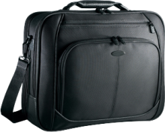
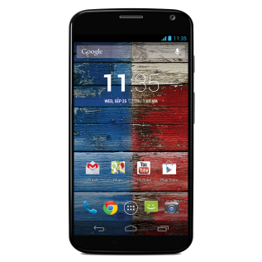
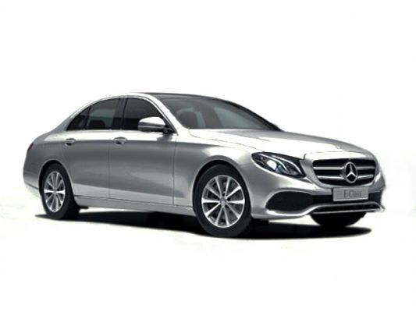
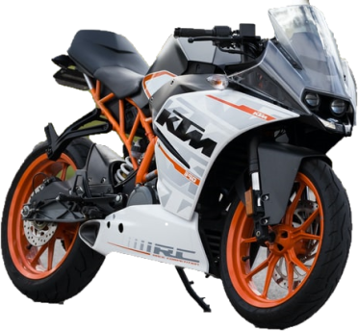
REWARDS INCENTIVE
WE PROVIDE REWARD ACCORDING TO SALES LEVEL
EXECUTIVE PROMOTER
STAR PROMOTER
Rs. 960000/-
Exc. Bag
SENIOR EXECUTIVE PROMOTER
SUPER STAR PROMOTER
Smart Phone
Rs. 2240000/-
DIRECTORIAL PROMOTER
Laptop
AMBASSADOR
Rs. 4000000/-
ADVICIVE PROMOTER
CROWN
AMBASSADOR
Rs.5,60,000/-
Rs. 6400000/-

Slide 43
REWARDS INCENTIVE
PERSONAL REFERENCE REWARD
SENIOR EXECUTIVE PROMOTER
SENIOR EXECUTIVE PROMOTER
If Your sales level is Senior Executive Promoter along with Your Direct Associate of Your Team also the same position, Senior Executive Promoter and above You get 10% his/her team sale incentives from them, it will calculate for his/her current team sales incentives as Personal Reference.

Slide 44
REWARDS INCENTIVE
CROWN
AMBASSADOR
AMBASSADOR
SUPER STAR PROMOTER
STAR PROMOTER
HONORARY REWARD
2% Honorary Incentive from Company Turnover are provided to SP AND ABOVE Share all
Among their Volumes

Slide 45
Our request:
The basic objective of this company is to create self-income by creating employment through entrepreneurship and to make indigenous product oriented consumers being aware about their health. Hence, we request all our distributor not to present yourself only as a sales motive persona forcefully to the consumer but also try to build a consumer society accordingly, realizing that every citizen has a responsibility towards the right use of their money and self-reliant economy.

Slide 46
Our request:
All distributors are requested to sincerely obey the rules of Direct sales (Management and regulation Act 2018 and rules 2019) issued by the Nepal government along with the guidelines and clause of the company. Company will not be responsible for not doing so.
Our products does not subject medical claim. The products acclaim nutritional benefits
Wish you all the best and good luck with your team….!

